Slide 1
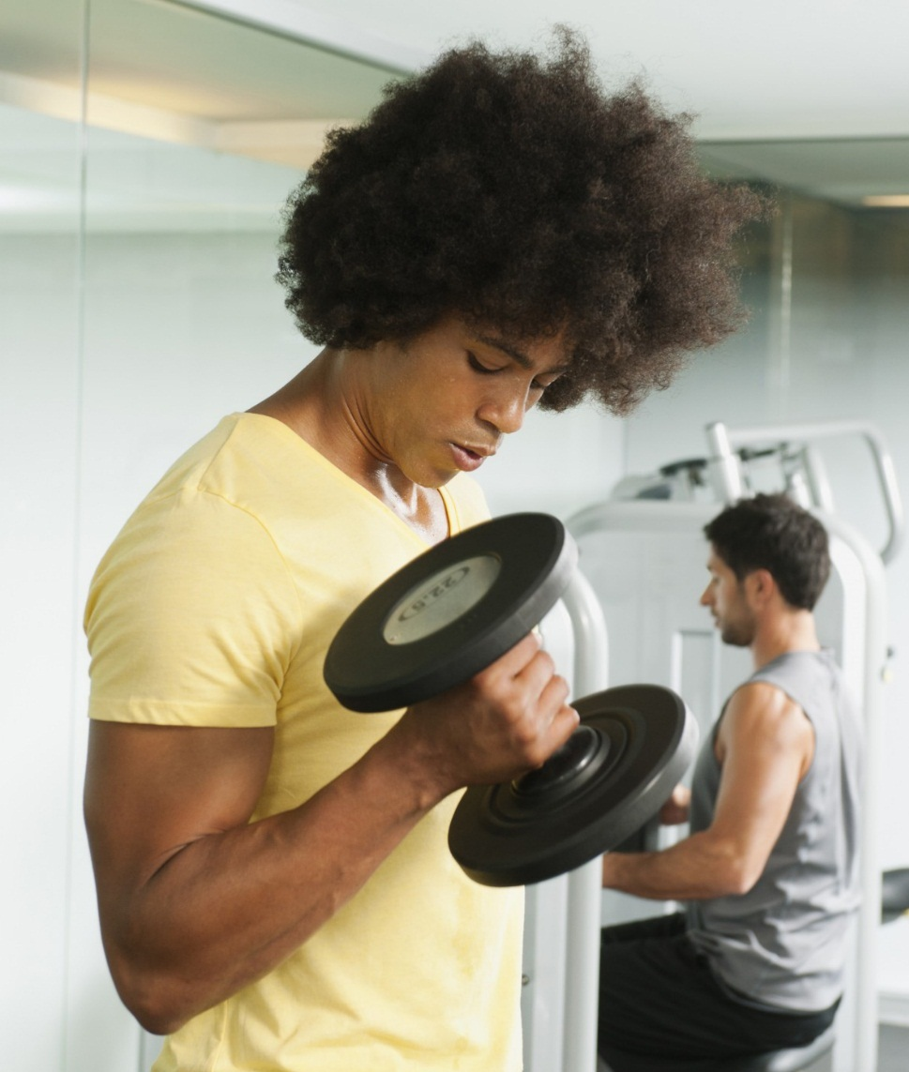
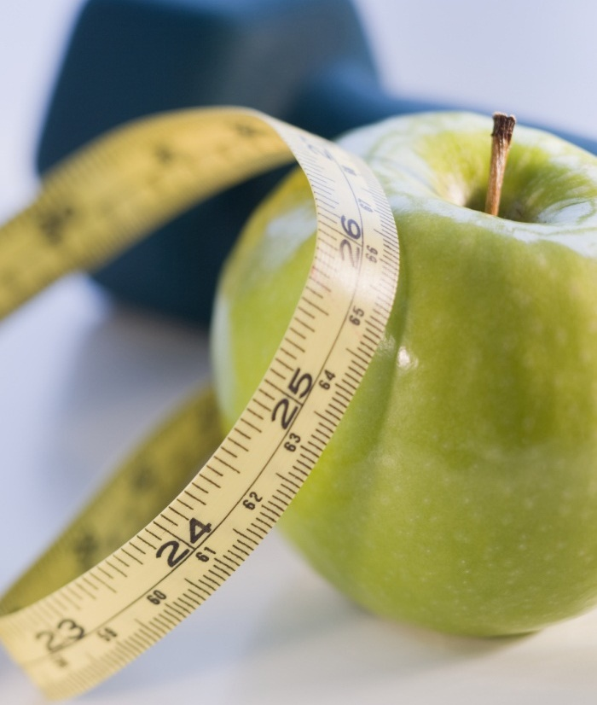
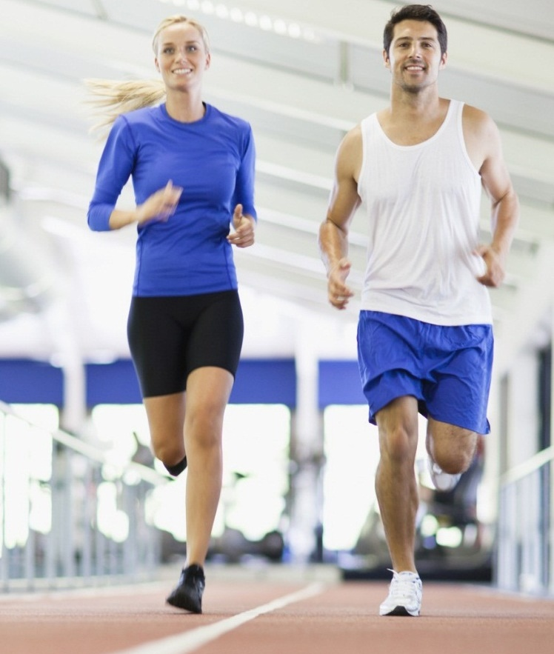
Digital Marketing Strategy for FitFreak
Elevating Fitness Journeys Through Strategic Online Presence

Slide 2
Agenda
Overview of Fitfreak
Website first Impression
User experience
Content Marketing
Service Offering
Community Building
Membership Plans
Conversion Strategy
Analytics and Optimization
Conclusion

Slide 3
Overview OF fitfreak
Initial Assessment
Customized Workout Plans
Personal Training Sessions
Nutritional Guidance and Diet Plans
Community Support and Accountability
Metrics Tracking and Progress Monitoring
Continuous Support and Education

Slide 4
Website first impression
Visuals
Tagline
Call of Action
Layout
Brand

Slide 5
User Experience
Visual Design Consistency
About Section
Facilities Section
Services Section
Community Section
Responsive Design
Accessibility Features
User Testing and Feedback

Slide 6
Content Marketing
Content Strategy:
Educational Articles
Success Stories
Expert Advice
Engagement Features:
Comment Section
Like Button
Share Options
Newsletter Signup
Promotion Strategy:
social Media Promotion
Email Marketing
SEO Optimization
Collaborations
Performance Tracking:
Analytics Tools
Feedback Collection
Goal Setting

Slide 7
Services Offerings
Diversity of Services:
Customization
Variety
Flexibility
Pricing Strategy:
Competitive Pricing
Transparency
Call to Action
Service Offerings:
Personal Training Sessions
Group Training
Full-Day Programs
Weekly Practices
Specialized Workshops

Slide 8
Community Building
Social Proof Section: Inviting Users to Join the FitFreak Community
Testimonials
Success Stories
User Statistics
Community Events
Engagement Tools: Features for Sharing Posts and Searching for Community Content
Social Sharing Buttons
Hashtags and Tagging
Search Functionality
Content Recommendations
Interactive Polls and Surveys

Slide 9
Membership Plans
Unlimited Plan
Package Plan
Limited Package
Yearly Pass
Yearly Unlimited Pass

Slide 10
CONVERSION STRATEGY
Lead Capturing Strategy
Conversion Funnels Strategy
Monitoring and Analysis
Case Studies or Success Stories

Slide 11
ANALYTICS AND OPTIMIZATION
Continuous Improvement
UX/UI Enhancements
Content Updates
Performance Tracking:
Traffic Monitoring
User Behavior Analysis
Conversion Tracking

Slide 12
Conclusion
Digital Marketing Strengths:
Enhanced reach: Tap into a global audience through various online channels.
Targeted advertising: Precision in reaching specific demographics and interests.
Measurable results: Analyze campaigns in real-time for better optimization.
Cost-effectiveness: Efficient allocation of resources for maximum impact.
Opportunities for FitFreak:
Social media engagement: Foster a community and brand advocates.
Influencer partnerships: Collaborate with fitness influencers to expand reach.
Content diversification: Explore various formats like videos, blogs, and podcasts.
SEO optimization: Improve visibility on search engines to attract organic traffic.

Slide 13
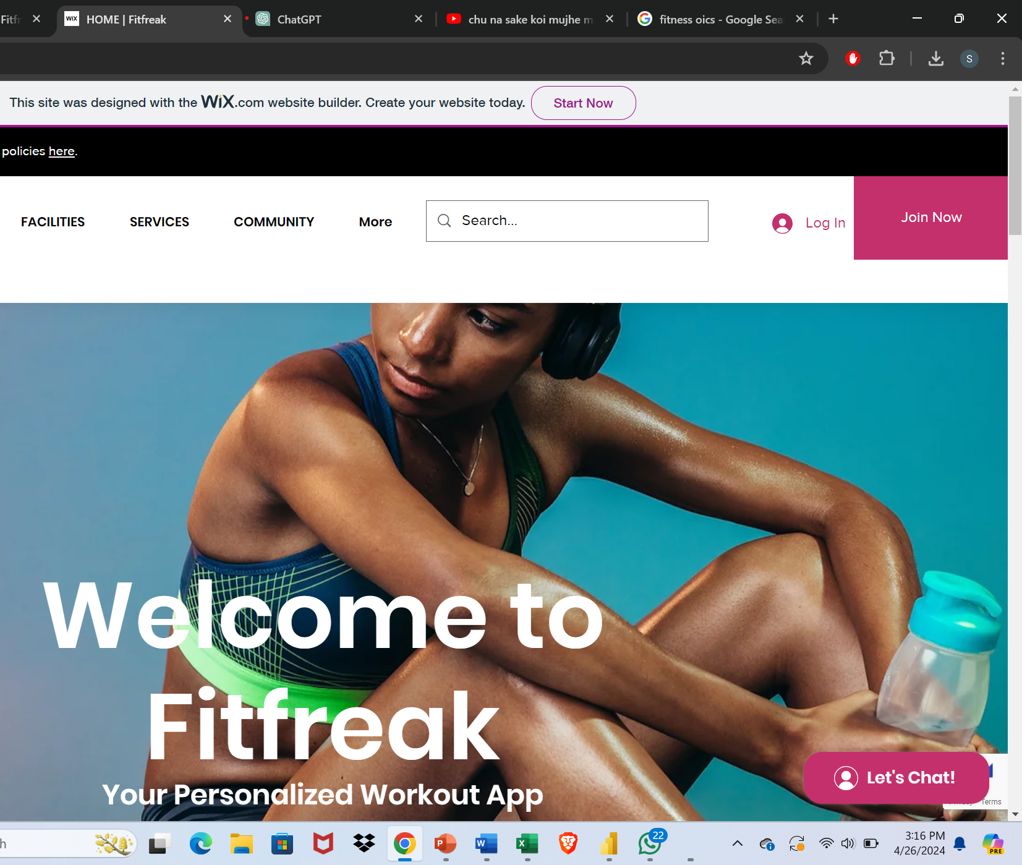
Website Overview
https://shreyamlbf538.wixsite
.com/fitfreak

Slide 14
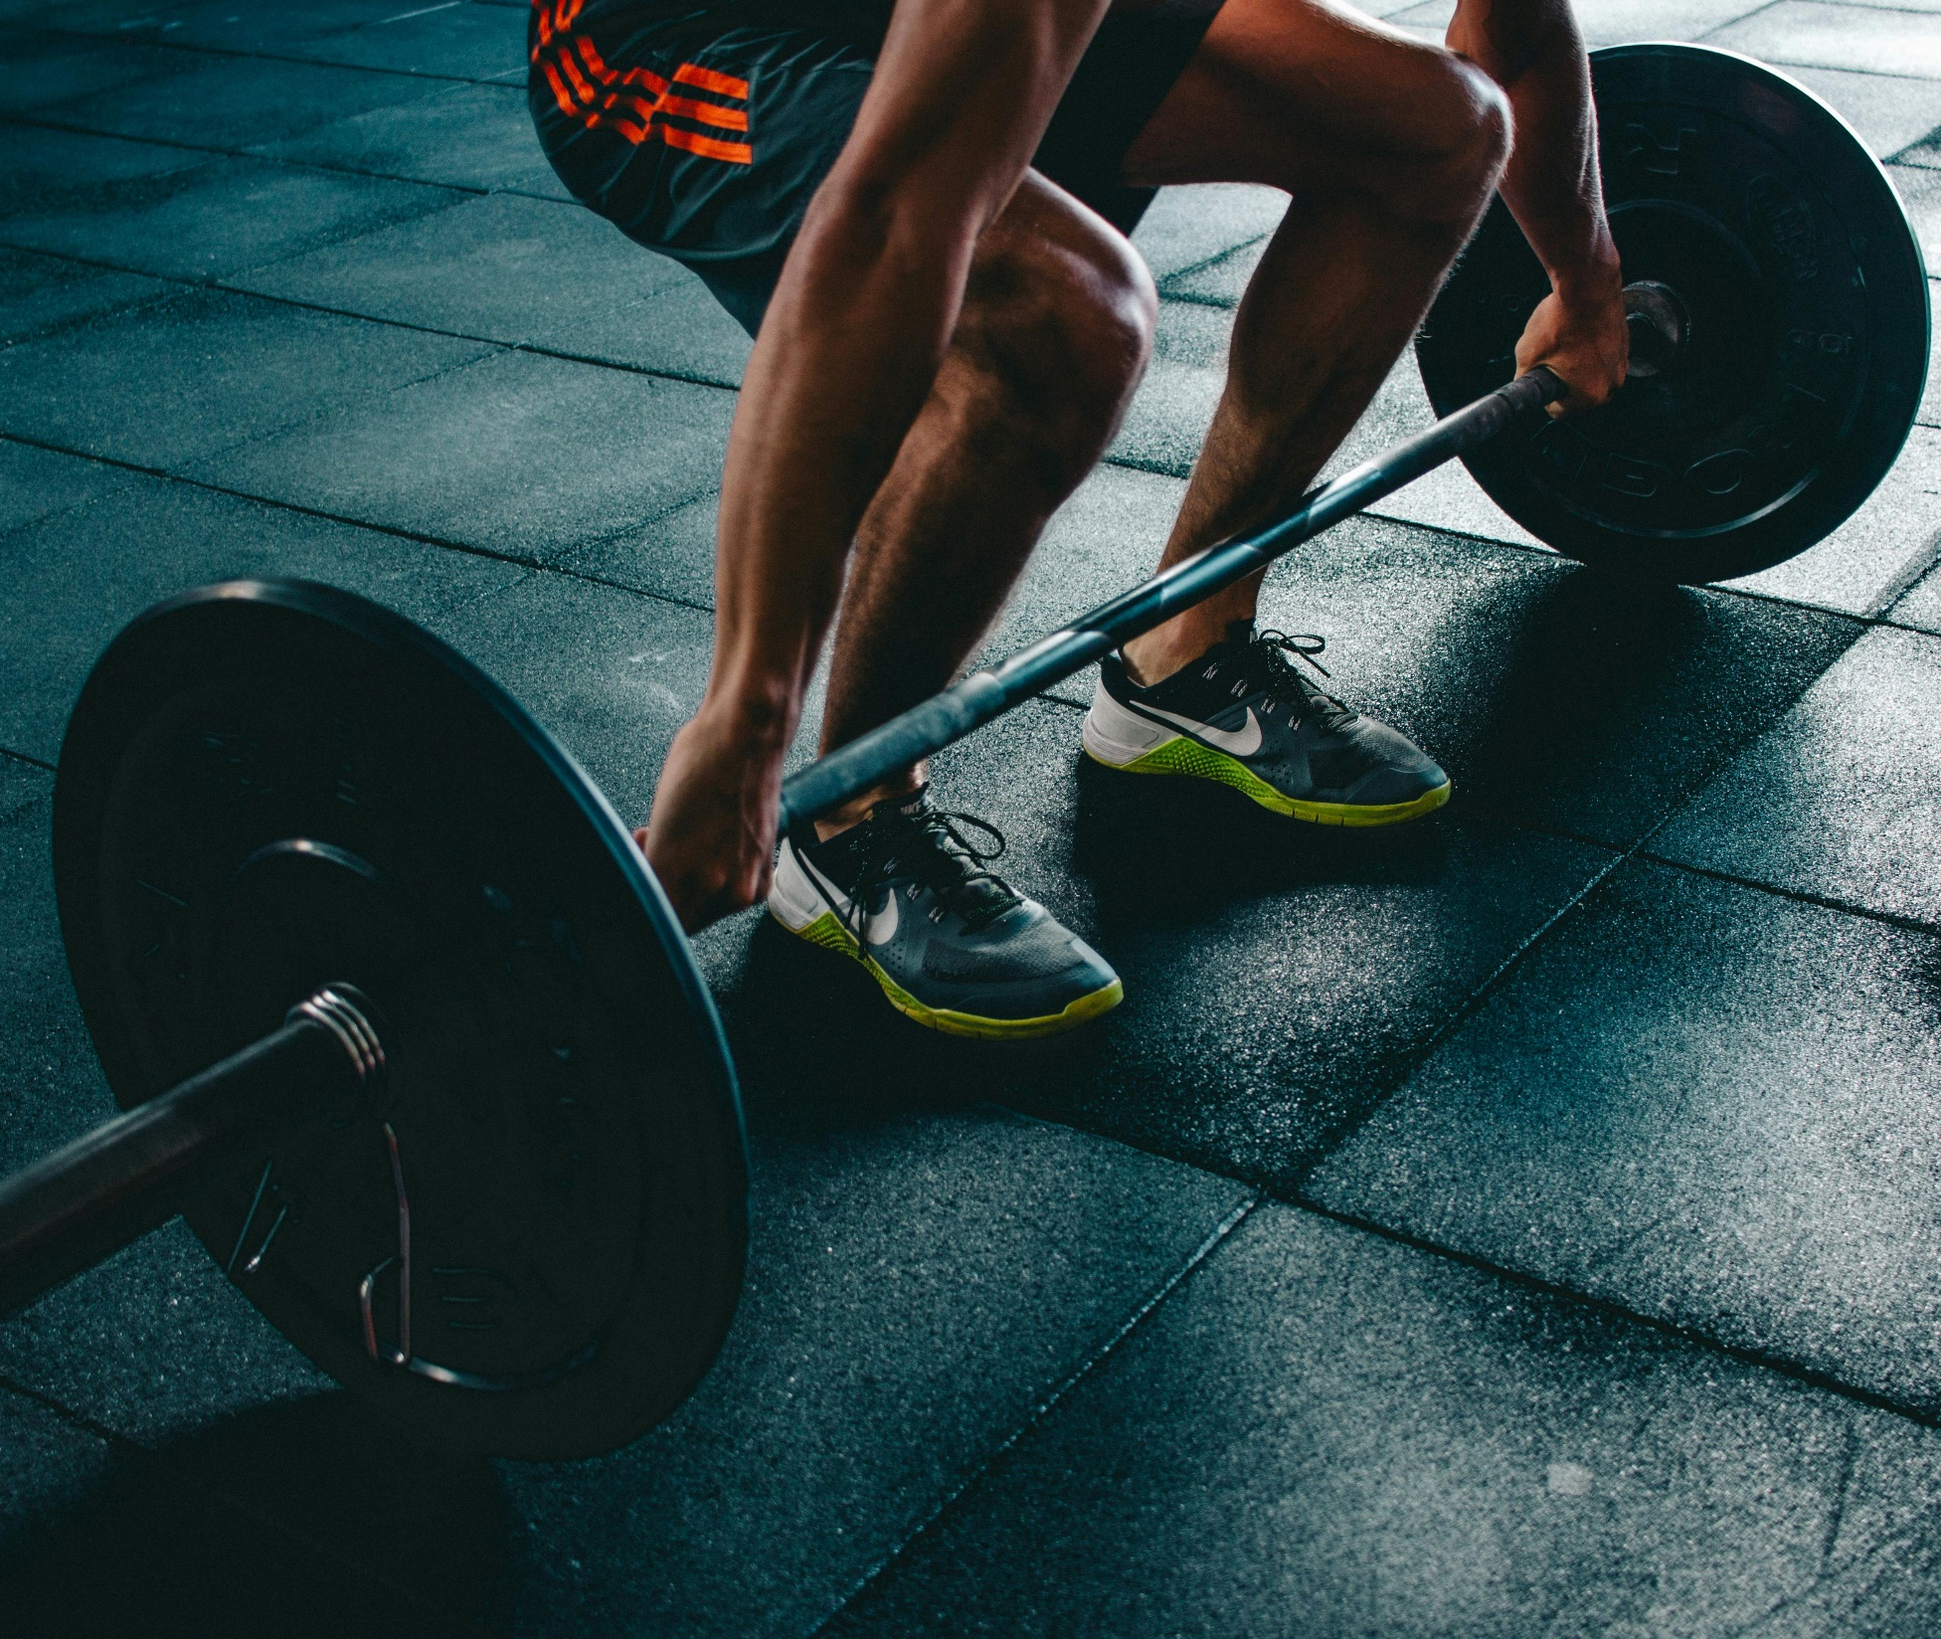
THANK YOU
Sonali
Shreya Motay

